Slide 1
Lextra
A new way to utilize your leisure time

Slide 2
Group members
Chengliao Xiang (Steven)
Database design, building lecture list, lecture details
Tiantuo Shi (Stone)
Login, user account, security
Ka Wai Hung (Jordan)
Bookmark, user preferences
Dayun Liu (Louis)
Home view, GPS, Google Maps, Search, Navigation
Xing Deng (Richard)
Side bar (redirects to account, bookmark, logout)

Slide 3
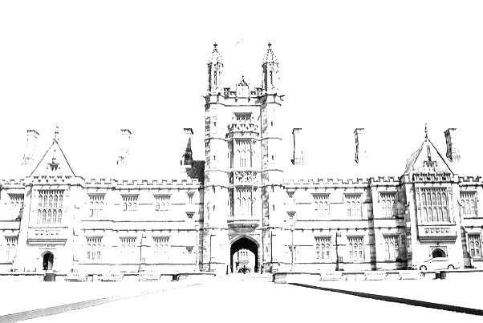
Motivation
Did you have a moment when you…
Curious about what other faculties offer
Hope to take more lectures outside your allowed ones
Want to make use of leisure time instead of playing with your phone
Or… simply want to explore the uni?

Slide 4
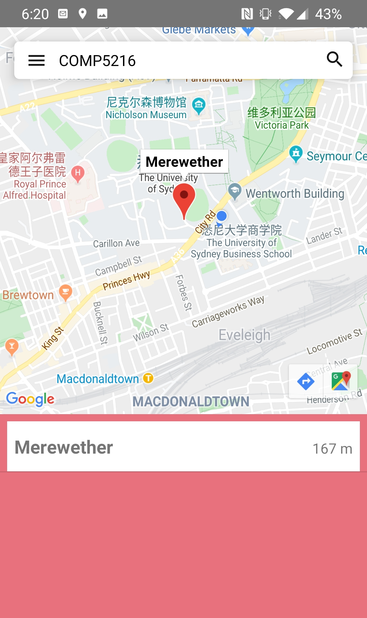
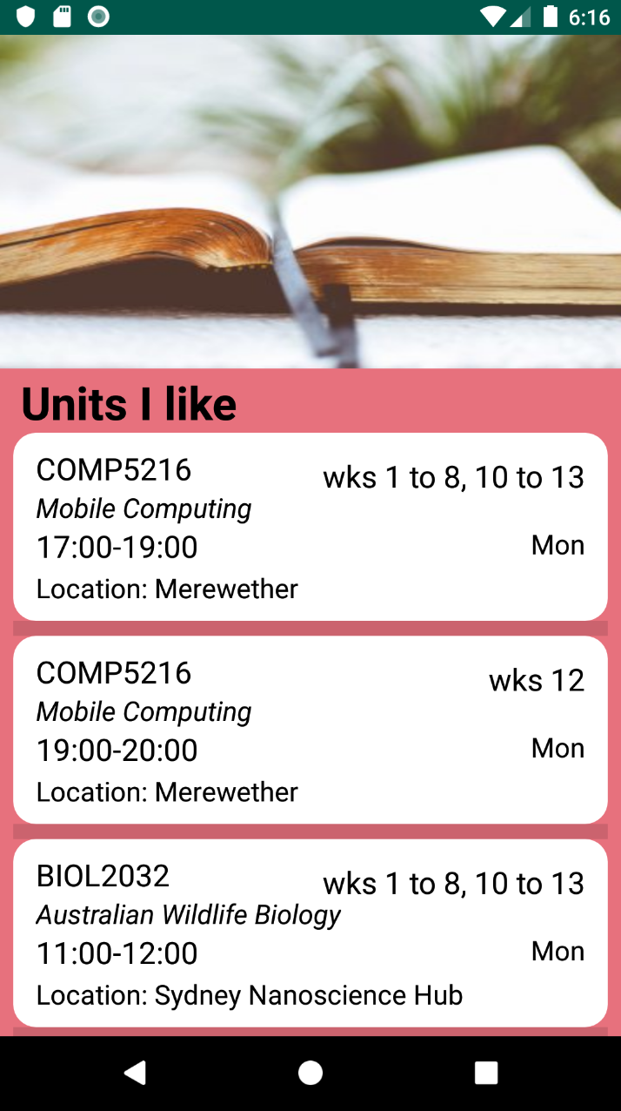
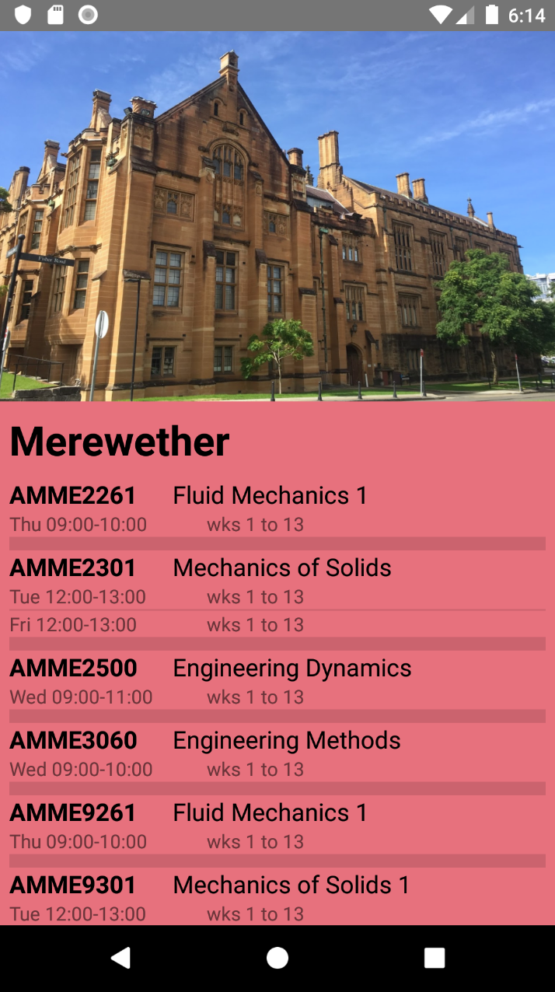
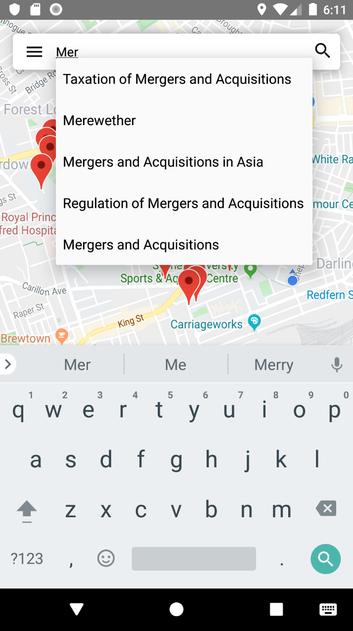
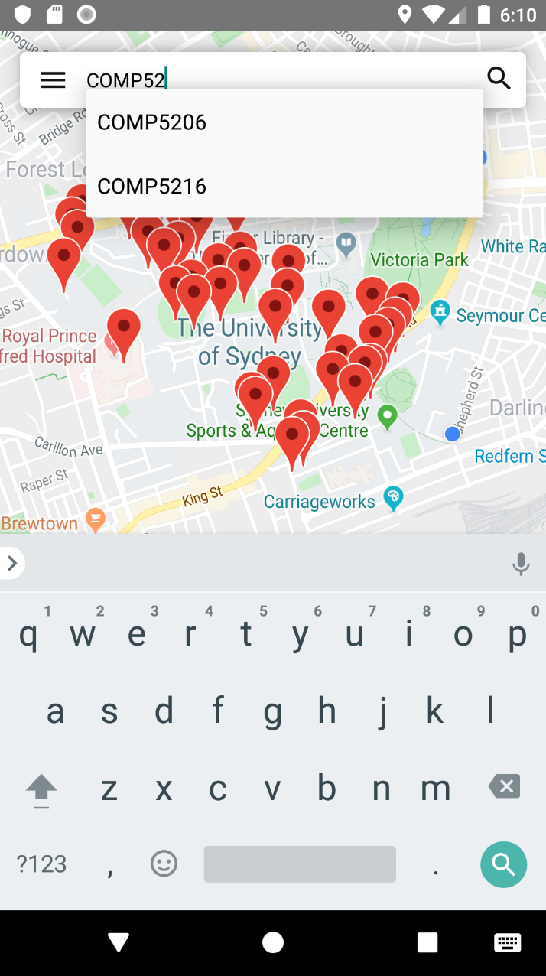
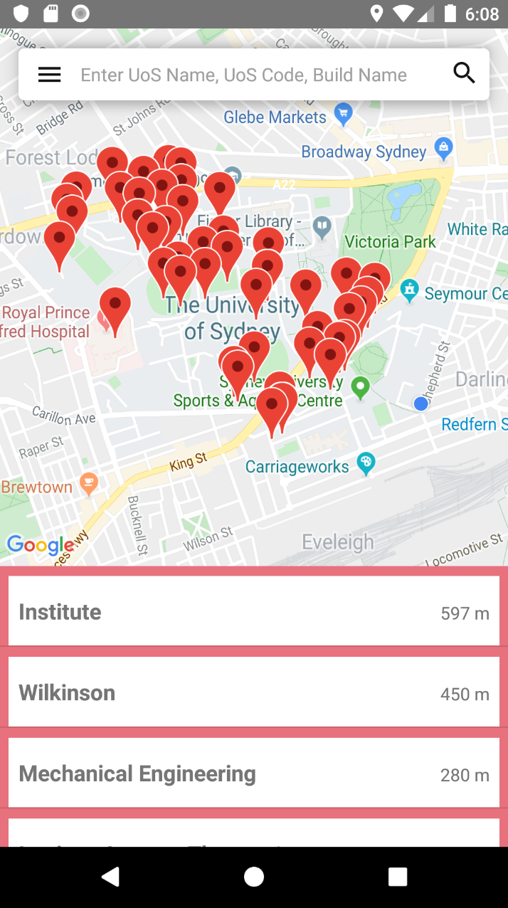
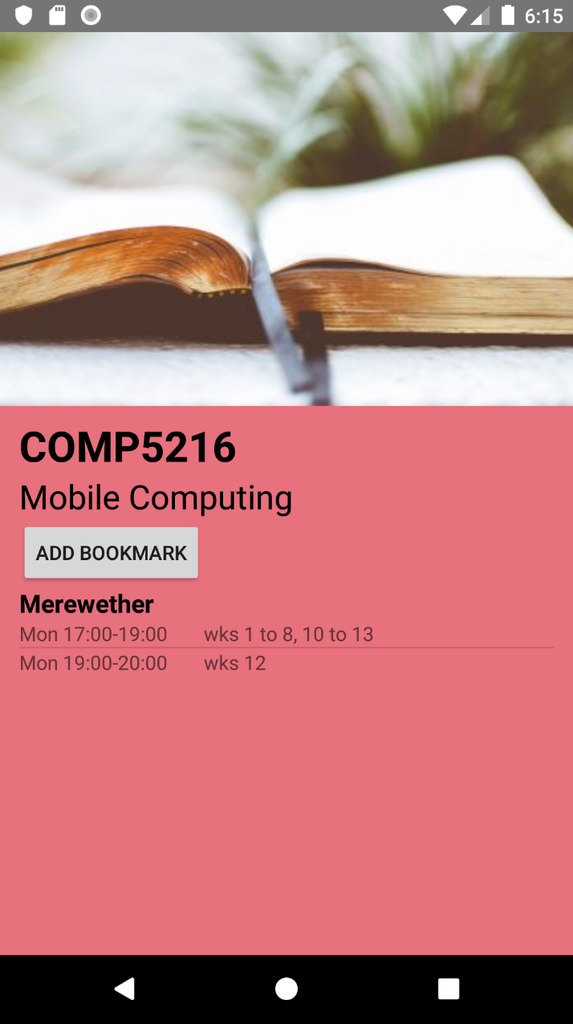
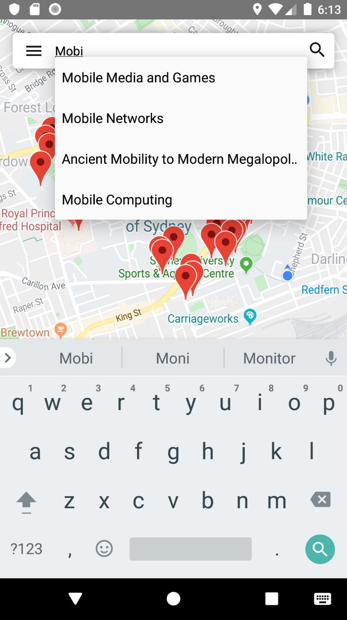
Then try our app!
Lextra means Lectures Extra where you can...
View USYD map marked with buildings
Search for buildings and lectures
See lectures held in a particular building
Check the details of a lecture
Bookmark a lecture
Navigate to your lecture building

Slide 5
Why we think it matters?
It would help you
Find new interests
Diversify knowledge background
Explore more career paths
It could eliminate your
Concerns with not being able to complete a difficult UoS
Restriction on maximum credits allowed by degree
It may promote
The significance of a UoS
The way the lecturer thinks about teaching
The competence of USYD graduates

Slide 6
Thank you

